Slide 1
Containers, Relations, and Abstract Data Types

Slide 2
Outline
This topic will describe
The storage of objects in containers
We will focus on linear orderings:
Implicitly defined linear orderings (sorted lists)
Explicitly defined linear orderings
We will summarize this information
We will also look briefly at:
Hierarchical orderings
Partial orderings
Equivalence relations
Adjacency relations

Slide 3
Outline
2.1
Any form of information processing or communication requires that data must be stored in and accessed from either main or secondary memory
There are two questions we should ask:
What do we want to do?
How can we do it?
This topic will cover Abstract Data Types:
Models of the storage and access of information
The next topic will cover data structures and algorithms:
The concrete methods for organizing and accessing data in the computer

Slide 4
Containers
2.1.1
The most general Abstract Data Type (ADT) is that of a container
The Container ADT
A container describes structures that store and give access to objects
The queries and operations of interest may be defined on:
The container as an entity, or
The objects stored within a container

Slide 5
Operations on a Container
2.1.1
The operations we may wish to perform on a container are:
Create a new container
Copy or destroy an existing container
Empty a container
Query how many objects are in a container
Query what is the maximum number of objects a container can hold
Given two containers:
Find the union (merge), or
Find the intersection

Slide 6
Operations on a Container
2.1.1
Many of these operations on containers are in the Standard Template Library
Constructor | Container()
Copy Constructor | Container( Container const & )
Destructor | ~Container()
Empty it | void clear()
How many objects are in it? | int size() const
Is it empty? | bool empty() const
How many objects can it hold? | int max_size() const
Merge with another container | void insert( Container const & )

Slide 7
Operations on Objects Stored in a Container
2.1.1
Given a container, we may wish to:
Insert an object into a container
Access or modify an object in a container
Remove an object from the container
Query if an object is in the container
If applicable, count how many copies of an object are in a container
Iterate (step through) the objects in a container

Slide 8
Operations on Objects Stored in a Container
2.1.1
Many of these operations are also common to the Standard Template Library
Insert an object | void insert( Type const & )
Erase an object | void erase( Type const & )
Find or access an object | iterator find( Type const & )
Count the number of copies | int count( Type const & )
Iterate through the objects in a container | iterator begin() const

Slide 9
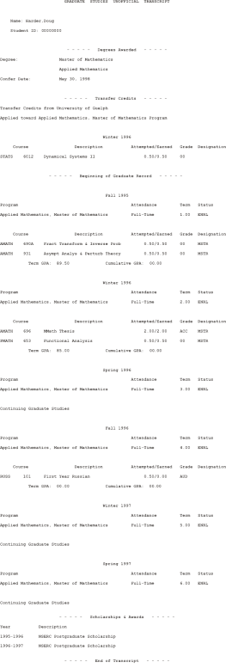
Simple and Associative Containers
2.1.2
We may split containers into two general classifications:
Simple Containers | Associative Containers
Containers that store individual objects | Containers that store keys but also store records associated with those keys
Temperature readings
UW Student ID Number
Circular
Array
QUEST
Academic
Server
Student
Academic
Record

Slide 10
Simple and Associative Containers
2.1.2
Any of the Abstract Data Types we will discuss can be implemented as either a simple container or an associative container
We will focus on simple containers in this course
Any container we discuss can be modified to store key-record pairs

Slide 11
Unique or Duplicate Objects
2.1.3
Another design requirement may be to either:
Require that all objects in the container are unique, or
Allow duplicate objects
Many of the containers we will look at will assume uniqueness unless otherwise stated
Dealing with duplicate objects is often just additional, and sometimes subtle, code

Slide 12
Standard Template Library
2.1.4
We will begin by introducing four containers from the C++ Standard Template Library (STL)
 | Unique Objects/Keys | Duplicate Objects/Keys
Simple Container | set<Type> | multiset<Type>
Associative Container | map<Key_type, Type> | multimap<Key_type, Type>

Slide 13
The STL set Container
2.1.4
#include <iostream>
#include <set>
int main() {
std::set<int> ints;
for ( int i = -100; i <= 100; ++i ) {
ints.insert( i*i ); // Ignores duplicates: (-3)*(-3) == 3*3
} // Inserts 101 values: 0, 1, 4, 9, ..., 10000
std::cout << "Size of 'is': " << ints.size() << std::endl; // Prints 101
ints.erase( 50 ); // Does nothing
ints.erase( 9 ); // Removes 9
std::cout << "Size of 'is': " << ints.size() << std::endl; // Prints 100
return 0;
}

Slide 14
Operations
2.1.5
In any application, the actual required operations may be only a subset of the possible operations
In the design of any solution, it is important to consider both current and future requirements
Under certain conditions, by reducing specific operations, the speed can be increased or the memory decreased

Slide 15
Relationships
2.1.5
However, we may want to store not only objects, but relationships between the objects
Consequently, we may have additional operations based on the relationships
Consider a genealogical database
We don’t only want to store the people, but we want to also make queries about the relationships between the people

Slide 16
Relationships
2.1.5.1
If we are not storing relationships, there is a data structure that is always the same speed no matter how many objects are stored
A hash table takes the same time to find an object whether there are 10 or one billion objects in the container
It requires approximately 30 % more memory than is occupied by the objects being stored
Example:
Assume a department has 12 staff that are frequently changing
Rather than having a mailbox for each person, have 24 mailboxes and place mail into the bin corresponding to the person’s last name
This works fine as long as there is not too much duplication
A | E | I | M | R | V
B | F | J | M | S | W
C | G | K | N | T | XY
D | H | L | PQ | U | Z

Slide 17
Relationships
2.1.5.2
Most interesting problems, however, have questions associated with relationships:
Which object has been stored the longest?
Are these two classes derived from the same base class?
Can I take ECE 427 if I failed ECE 250?
Do both these pixels represent pavement on this image?
Can I get from here to Roches’s Point in under two hours?

Slide 18
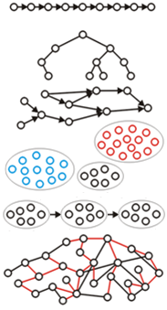
Relationships
2.1.5.2
We will look at six relationships:
Linear orderings
Hierarchical orderings
Partial orderings
Equivalence relations
Weak orderings
Adjacency relations

Slide 19
Relationships
2.1.5.2
Relationships are often Boolean-valued binary operations
Example: given two integers:
Are they equal? x = y
Is one less than the other? x < y
Does the first divide the second? x | y
Do they have the same remainder modulo 16?
Do two integers differ by at most one prime factor?

Slide 20
Classification of Relationships
2.1.5.3
The relationships we look at can usually be classified by one of two properties based on symmetry:
Another common property is transitivity:
If x ~ y and y ~ z, it must be true that x ~ z :
If Ali is the same age as Bailey and Bailey is the same age as Casey, it follows that Ali is the same age as Casey.
If x < y and y < z, it must be true that x < z :
If Ali is shorter than Bailey and Bailey is shorter than Casey, it follows that Ali is shorter than Casey.
Symmetric | x ~ y if and only if y ~ x | Ali is the same age as Bailey
Anti-symmetric | at most one of x < y or y < x can be true | Ali is shorter than Bailey ECE 150 is a prereq of ECE 250
Reflexive | x ~ x for all x | Ali is the same age as Ali
Anti-reflexive | x ≮ x for all x | Ali is not shorter than Ali

Slide 21
Definitions and examples
2.1.6
We will now define and consider examples of these relationships
Linear orderings
Hierarchical orderings
Partial orderings
Equivalence relations
Weak orderings
Adjacency relations

Slide 22
Linear Orderings
2.1.6.1
A linear ordering is any relationship where any two objects x and y that can be compared, exactly one of:
x < y , x = y, or y < x
is true and where the relation is transitive
Such a relation is therefore anti-symmetric
Any collection can therefore be sorted according to this relation
Examples of sets which are linearly ordered include:
Integers 1, 2, 3, 4, 5, 6, ...
Real numbers 1.2, 1.2001, 1.24, 1.35, 2.78, ...
The alphabet a, b, c, d, e, f, ..., x, y, z
Memory 0x00000000, 0x00000001, ..., 0xFFFFFFFF
We could store linearly ordered sets using arrays or linked lists

Slide 23
Lexicographical Orderings
2.1.6.1.1
Another linearly ordered set is the set of English words:
a, aardvark, aardwolf, ..., abacus, …, baa, …, bdellium, ..., zygote
The order is induced by the linear ordering on a through z
We will add the blank character b which has the property that b < a
The order is determined by comparing the first letters which differ:
aardvark < aardwolf since v < w
aadvark < abacus since a < b
azygous < baa since a < b
cat < catch since b < c
wilhelm < william since h < l
/
/
/

Slide 24
Lexicographical Orderings
2.1.6.1.1
Such an order can also be used to linearly order vectors:
Say that (x₁, y₁) < (x₂, y₂) if either:
x₁ < x₂ or both x₁ = x₂ and y₁ < y₂
For example,
(3, 4) < (5, 1) (3, 4) < (3, 8)
cd < ea cd < ch

Slide 25
Operations on Linear Orderings
2.1.6.1.2
Queries that may be asked about linear orderings:
What are the first and last objects (the front and the back)?
What is the k^{th} object?
What are all objects on a given interval [a, b]
Given a reference to one object in the container:
What are the previous and next objects?
Operations that may be performed as a result:
Insert an object into a sorted list
Insert an object at either the front, the back, or into the k^{th} position
Sort a collection of objects

Slide 26
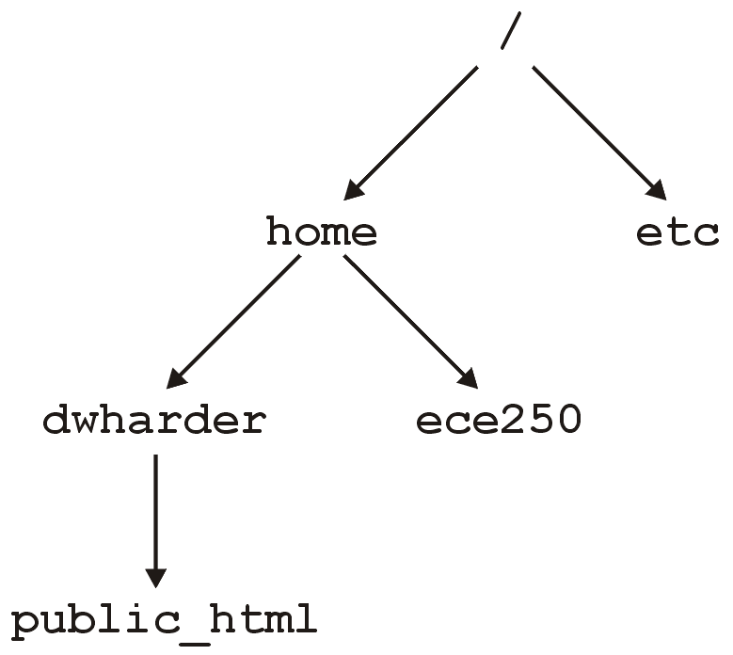
Hierarchical Orderings
2.1.6.2
The next relation we will look at is a hierarchical ordering
Consider directories in a file system:
x ≺ y if x contains y within one of its subdirectories
In Unix, there is a single root director /
Such structures allow us to organize information

Slide 27
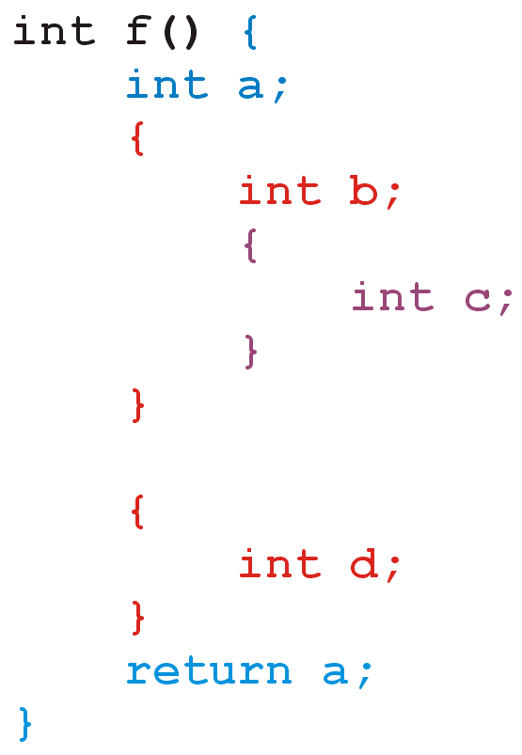
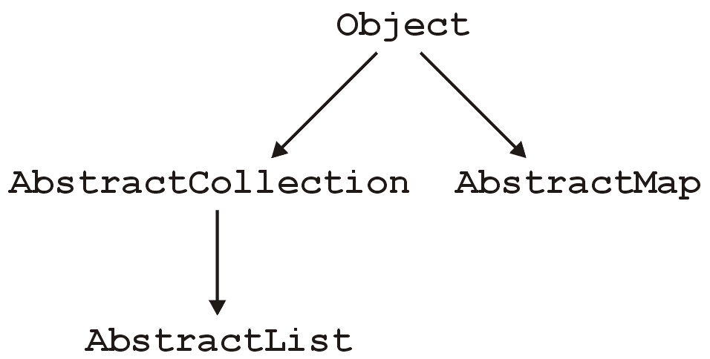
Hierarchical Orderings
2.1.6.2.1
Other examples:
Classes in Java and C#

Slide 28
Hierarchical Orderings
2.1.6.2.2
If x ≺ y, we say that x precedes y or x is a predecessor of y
Even though all of these relationships may appear very different, they all exhibit the same properties:
For all x, x ⊀ x (anti-reflexive)
If x ≺ y then y ⊀ x
If x ≺ y and y ≺ z, it follows that x ≺ z
There is a root r such that r ≺ x for all other x
If is x ≺ z and y ≺ z, it follows that either x ≺ y, x = y or x ≻ y

Slide 29
Operations on Hierarchical Orders
2.1.6.2.3
If the hierarchical order is explicitly defined (the usual case), given two objects in the container, we may ask:
Does one object precede the other?
Are both objects at the same depth?
What is the nearest common predecessor?
Notes:
29

Slide 30
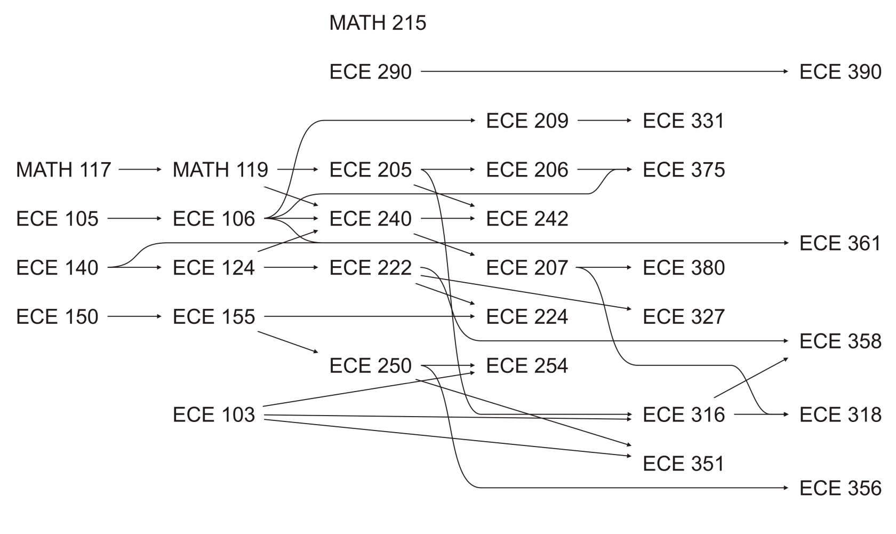
Partial Orderings
2.1.6.3
The next relationship we will look at is
x ≺ y if x is a prerequisite of y
This is not a hierarchy, as there are multiple starting points and one class may have multiple prerequisites

Slide 31
Partial Orderings
2.1.6.3
Arrows are necessary to indicate the direction:
Having completed ECE 140, you can now take ECE 124 and ECE 361
If you want to take ECE 375 Electromagnetic fields and waves, you must take ECE 206

Slide 32
Partial Orderings
2.1.6.3
There are no loops—otherwise, you could not take any courses in the loop…

Slide 33
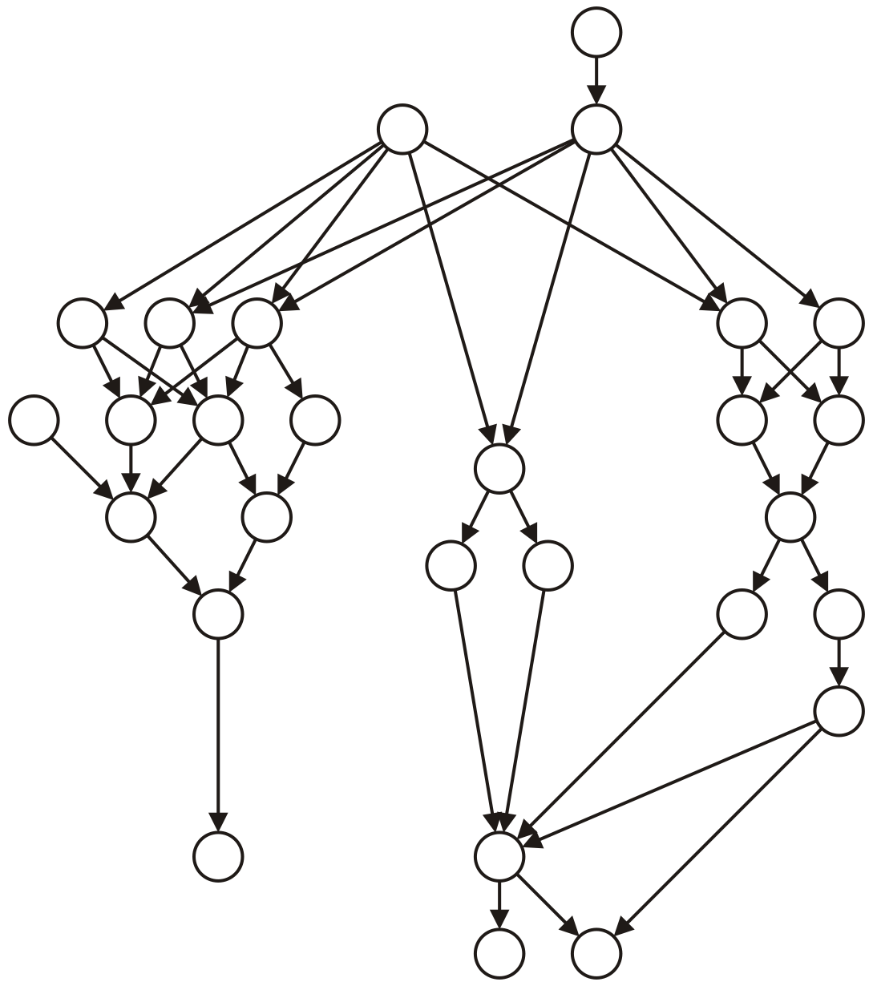
Partial Orderings
2.1.6.3.1
Examples:
C++ classes (multiple inheritance–a class can inherit from more than one class), and
A number of tasks which must be completed where particular tasks must be completed before other tasks may be performed
Compilation dependencies

Slide 34
Partial Orderings
2.1.6.3.2
All partial orderings are anti-reflexive, anti-symmetric and transitive
You will note that these are the first three rules of a hierarchical ordering
What is lost?
We are not guaranteed that there is a unique root
There may be multiple different paths between two objects

Slide 35
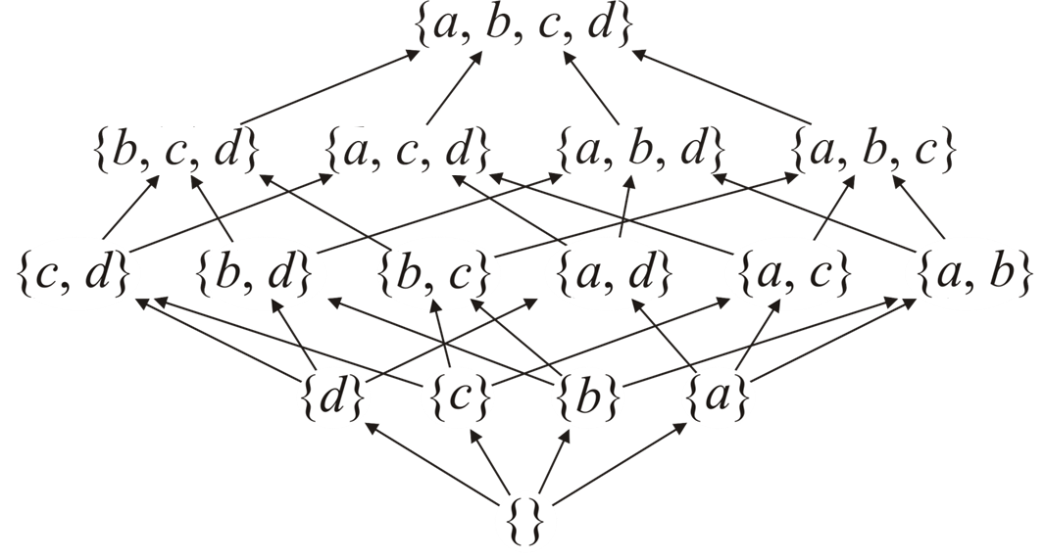
Lattice
2.1.6.3.3
A finite set L that is partially ordered is called a lattice if it has a there are unique elements ⊤ and ⊥ such that ⊥ ≼ x and x ≼ ⊤ for all elements x ∈ L
Here, A ≺ B if A ⊂ B
Graphically, A ≺ B if there is a path from A to B
⊤ =
⊥ =

Slide 36
Operations on Partial Orderings
2.1.6.3.4
Partial orders are similar to hierarchical orders; consequently, some operations are similar:
Given two objects, does one precede the other?
Which objects have no predecessors?
Not unique (unlike a hierarchy)
Which objects immediate precede an object?
A hierarchical order has only one immediate predecessor
Which objects immediately succeed an object?
Notes:
36

Slide 37
Equivalence Relations
2.1.6.4.1
Consider the relationship
x ~ y if x and y are of the same gender
Here we have another set of properties:
This relationship is symmetric and transitive, but it is also reflexive:
x ~ x for all x

Slide 38
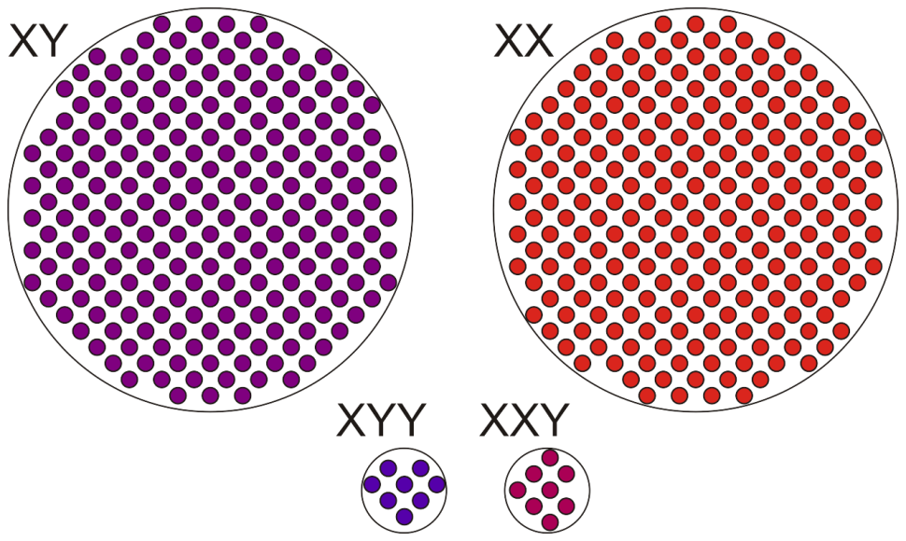
Equivalence Relations
2.1.6.4.1
One nice property of equivalence relations is that you can create equivalence classes of objects where each object in the class are related
If you consider genetics, there are four general equivalence classes

Slide 39
Equivalence Relations
2.1.6.4.2
Mathematically, we could say that two functions f(x) and g(x) are equivalent if
for some value of c that is
Two circuits, one from Motorola and the other from IBM, may be said to be equivalent if they perform the same operations
Notes:
39

Slide 40
Operations on Equivalence Relations
2.1.6.4.3
Given an equivalence relation:
Are two objects related?
Iterate through all objects related to one particular object
Count the number of objects related to one particular object
Given two objects x and y which are not currently related, make them related (union)
Not so easy: everything related to x must now be related to everything related to y
Notes:
40

Slide 41
Weak Orderings
2.1.6.5
Finally, we will look at the relationship
x ~ y if x and y are the same age
and
x < y if x is younger than y
A weak ordering is a linear ordering of equivalence classes
If x is the same age or younger than y, we would say x ≲ y

Slide 42
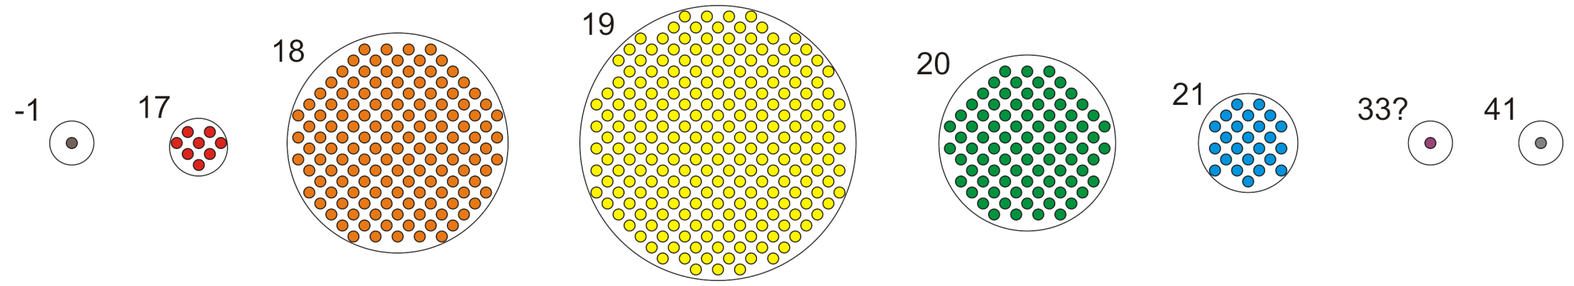
Weak Orderings
2.1.6.5
One nice property of equivalence relations is that you can create groups of objects where each object in the group has the same properties

Slide 43
Weak Orderings
2.1.6.5.1
The four containers,
set<T> multiset<T> map<K, S> multimap<K, S>
expect that the objects/keys may be compared using the relational operators and that relational operator must satisfy a weak ordering
The set/map will store only one object/key per equivalence class
The multiset/multimap will store multiple objects in each equivalence class
The containers do not guarantee the same internal ordering for objects that are equivalent

Slide 44
Operations on Weak Orderings
2.1.6.5.2
The operations on weak orderings are the same as the operations on linear orderings and equivalence classes, however:
There may be multiple smallest or largest objects
The next or previous object may be equivalent

Slide 45
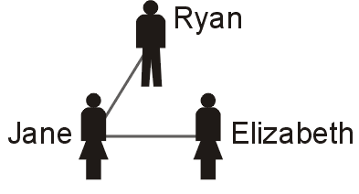
Adjacency Relations
2.1.6.6
The last relationship we will look at is
x ↔ y if x and y are friends
Like a tree, we will display such a relationship by displaying a line connecting two individuals if they are friends (a graph)
E.g., Jane and Ryan are friends, Elizabeth and Jane are friends, but Elizabeth thinks Ryan is a little odd...

Slide 46
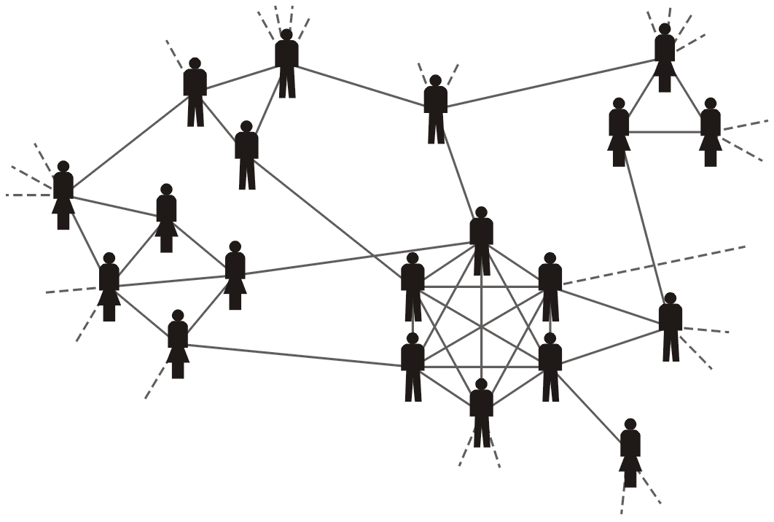
Adjacency Relations
2.1.6.6
Such a relationship is termed an adjacency relationship
Two individuals who are related are also said to be adjacent to each other
Here we see a hockey team and some of their friends

Slide 47
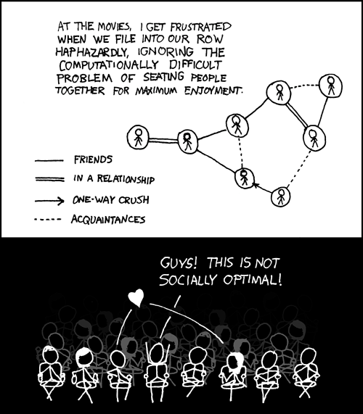
Adjacency Relations
2.1.6.6
Alternatively, the graph may be more complex
http://xkcd.com/173/

Slide 48
Adjacency Relations
2.1.6.6
In some cases, you do not have global relationships, but rather, you are simply aware of neighbouring, or adjacent, nodes
Such a relationship defines a graph, where:
Nodes are termed vertices
Edges denote adjacencies

Slide 49
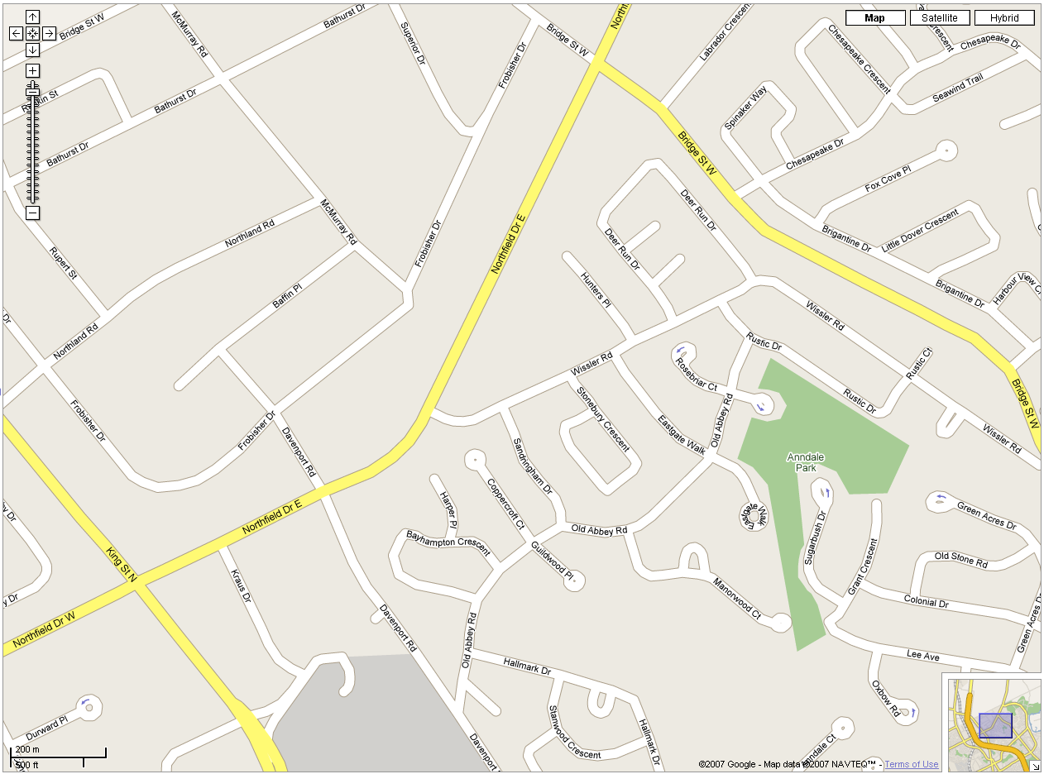
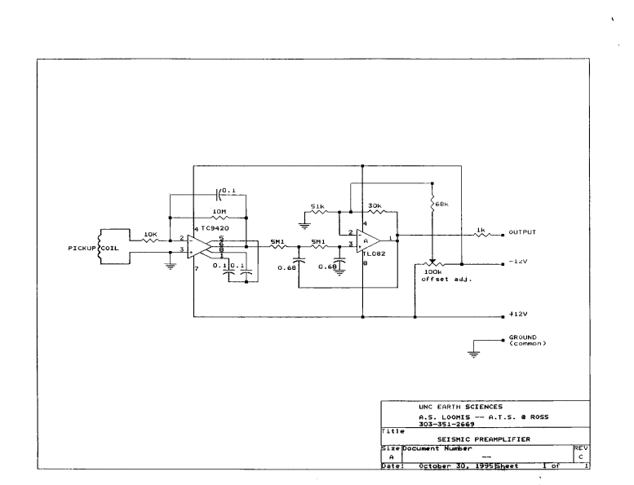
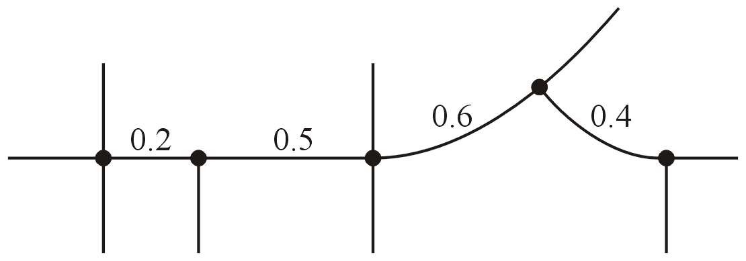
Adjacency Relations
2.1.6.6
Two examples:
City streets
intersections are vertices
streets are edges
Circuits
circuit elements are vertices
connections are edges
http://maps.google.ca/
http://esci.unco.edu/resource/circuit.htm

Slide 50
Operations on Adjacency Relations
2.1.6.6.1
Given an adjacency relation:
Are two objects adjacent?
Iterate through all objects adjacent to one object
Given two objects a and b, is there a sequence of objects
a = x₀, x₁, x₂, x₃, ..., x_{n} = b
such that x_{k} is adjacent to x_{k + 1}?
I.e., are the objects connected?
Notes:
50

Slide 51
Summary of Relations
2.1.6.6
We have now seen six relationships:
Linear orderings
Hierarchical orderings
Partial orderings
Equivalence relations
Weak orderings
Adjacency relations
All of these are relationships that exist on the objects we may wish to store, access, and query
Notes:
51

Slide 52
Defining Relations
2.1.7
Any relationship may be either implicitly defined or explicitly imposed
Integers are implicitly ordered based on their relative values
Age groups are defined by the properties of the individuals

Slide 53

Defining Relations
2.1.7
Any relationship may be either implicitly defined or explicitly imposed
A hierarchy in a company is explicitly defined
The order of the letters on this slide are explicitly imposed by the author
Pixels are defined as pavement based on explicitly imposed rules based on colour and surrounding pixels

Slide 54
Defining Relations
2.1.7.1
Relationships may be defined globally or locally
Any two integers may be compared without reference to other integers
Any two sets can be compared to determine if one is a subset of the other

Slide 55
Defining Relations
2.1.7.2
Relationships may be defined globally or locally
Prerequisites are defined locally:
ECE 150 is a prerequisite of ECE 155
ECE 155 is a prerequisite of ECE 250
From these, we may deduce that ECE 150 is a prerequisite of ECE 250
Relationships in a company are defined locally:
Person X reports directly to person Y
Person Z is the president (or root) of the hierarchy
Street grids and circuits are defined locally:
These two intersections are connected by a road
These two circuit elements are connected by a wire

Slide 56
Defining Relations
2.1.7.3
In general,
Explicitly imposed relationships are usually defined locally
Implicitly defined relationships can usually be determined globally

Slide 57
Abstract Data Types
2.1.8
In engineering, we tend to see certain patterns that occur over and over in applications
In these circumstances, we first name these patterns and then proceed to define certain standard solutions or implementations
In software in storing objects and relationships in containers, there are reoccurring containers of objects and associated relationships where the actual queries and operations are restricted
We model such containers by Abstract Data Types or ADTs
Notes:
57

Slide 58
Abstract Data Types
2.1.8
Any time you are intending to store objects, you must ask:
What are the relationships on the objects?
What queries will be made about the objects in the container?
What operations will be performed on the objects in the container?
What operations may be performed on the container as a whole?
What queries will be made about the relationships between the objects in the container?
What operations may be made on the relationships themselves between the objects in the container?
Notes:
58

Slide 59
Abstract Data Types
2.1.8
Throughout this course, we will describe various ADTs and then look at various data structures that will allow us to efficiently implement the required queries and operations defined by the ADT
We have already discussed one ADT and a corresponding implementation:
The Container ADT and the hash table data structure
Notes:
59

Slide 60
Abstract Data Types
2.1.8
Another ADT is the Sorted List ADT
A container that stores linearly ordered objects where we may want insert, access, or erase objects at arbitrary locations
You may immediately think that we could using either an array or a linked list to implement the Sorted List ADT; however, we will see that that is usually very inefficient
They are so inefficient that if, by the end of the class, if the first thing you think of is using an array or linked list to store sorted objects, I’ve done something wrong…
Notes:
60

Slide 61
What’s next?
2.1.8
We have discussed containers, relationships, and ADTs
What is it we want to store and access
What queries and operations are we interested in
The next question is, how do we implement these efficiently on a computer?
The next step is to look at data structures
These are particular methods of storing and relating data on the computer
One data structure may be appropriate as an implementation for numerous ADTs
It may not be possible to find a data structure that allows optimal implementations for all queries and operations of a particular ADT
Notes:
61

Slide 62
Summary
In this topic, we have covered:
The Container ADT as a basic model of organizing data
Queries and operations on containers
Simple and associative containers
Unique or duplicate objects
Relationships between data
Linear ordering
Lexicographical ordering
Hierarchical ordering
Partial ordering
Equivalence relation
Weak ordering
Adjacency relation
In each case, we considered relationship-specific queries and operations
Abstract Data Types as a model for organizing information
Notes:
62

Slide 63
References
Wikipedia, http://en.wikipedia.org/wiki/Container_(abstract_data_type)
http://en.wikipedia.org/wiki/Binary_relation
These slides are provided for the ECE 250 Algorithms and Data Structures course. The material in it reflects Douglas W. Harder’s best judgment in light of the information available to him at the time of preparation. Any reliance on these course slides by any party for any other purpose are the responsibility of such parties. Douglas W. Harder accepts no responsibility for damages, if any, suffered by any party as a result of decisions made or actions based on these course slides for any other purpose than that for which it was intended.

